Slide 1
Digital Portfolio
STUDENT NAME: R.Harini Priya
NMID: F69B3EE4341BB48AA8E46E3FA26A5707
DEPARTMENT: B.Sc. Computer Science
COLLEGE: Krishnasamy College of Science,Arts & Management for Women.

Slide 2
PROJECT TITLE
DIGITAL PORTFOLIO

Slide 3


AGENDA
Problem Statement
Project Overview
End Users
Tools and Technologies
Portfolio design and Layout
Features and Functionality
Results and Screenshots
Conclusion
Github Link
3/21/2024 Annual Review

Slide 4

PROBLEM STATEMENT
Traditional resumes and printed portfolios are static, limited in creativity, and difficult to update. In today’s digital era, students and professionals require a dynamic platform to showcase their skills, projects, achievements, and creativity in an interactive and easily accessible way. A digital portfolio solves this by providing a modern, customizable, and updatable solution that highlights individuality and improves career opportunities.

Slide 5

PROJECT OVERVIEW
The Digital Portfolio project aims to design and develop an online platform that allows individuals to present their personal, academic, and professional information in an interactive and visually appealing way. It includes sections such as: Personal Information Educational Background Skills & Certifications Projects & Achievements Work Samples / Creative Works

Slide 6

WHO ARE THE END USERS?
Students – to showcase academic work, projects, and skills Job Seekers – to present resumes and achievements professionally Teachers/Trainers – to display teaching materials & certifications Freelancers/Professionals – to highlight creative works and client projects

Slide 7

TOOLS AND TECHNIQUES
Frontend Tools – HTML, CSS, JavaScript, React Backend Tools – Node.js / PHP / Python (Django, Flask) Database – MySQL / MongoDB / Firebase Design Tools – Canva, Figma, Adobe XD Techniques – Responsive Design, User-Centered Design, Version Control (Git), Hosting & Deployment (GitHub Pages / Netlify)

Slide 8
POTFOLIO DESIGN AND LAYOUT
Clean & Professional Look – Simple, neat, and organized design gives a good impression. Consistent Theme – Same color palette, fonts, and style throughout the portfolio. Navigation Friendly – Easy to move between sections (About, Projects, Skills, Contact). Visual Balance – Proper spacing, alignment, and structure for readability. Use of White Space – Avoid clutter; highlight only important content.
8

Slide 9
FEATURES AND FUNCTIONALITY
Clean & Professional Look – Simple, neat, and organized design gives a good impression. Consistent Theme – Same color palette, fonts, and style throughout the portfolio. Navigation Friendly – Easy to move between sections (About, Projects, Skills, Contact). Visual Balance – Proper spacing, alignment, and structure for readability.

Slide 10
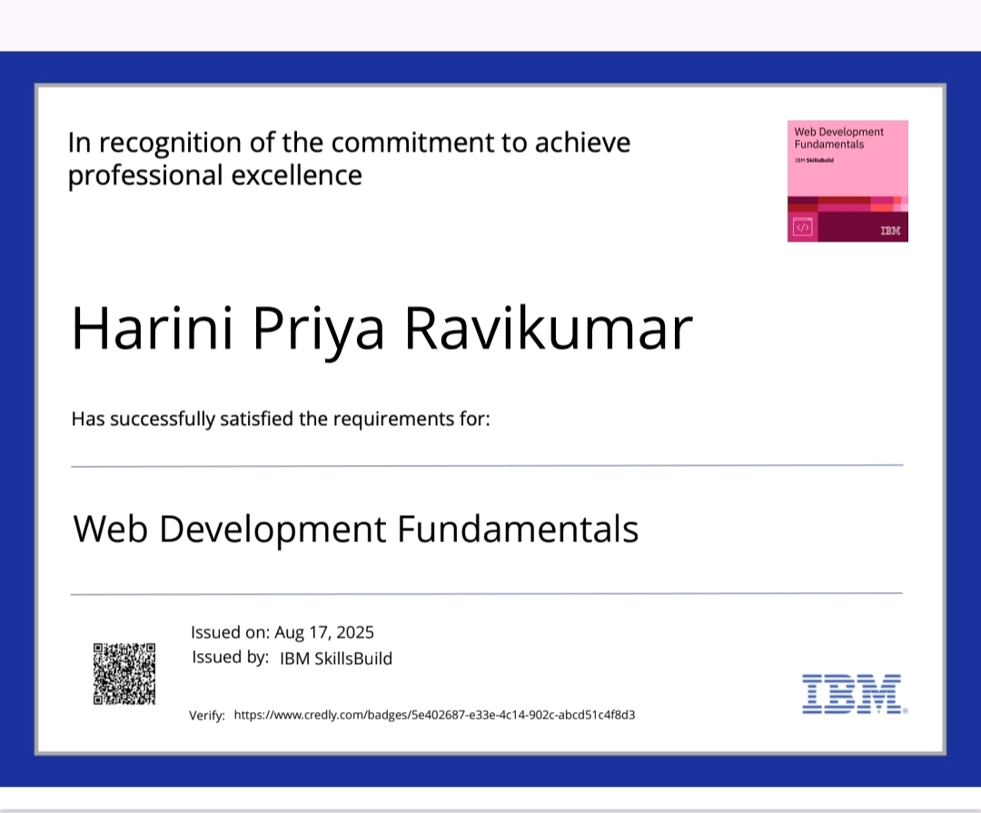

RESULTS AND SCREENSHOTS

Slide 11
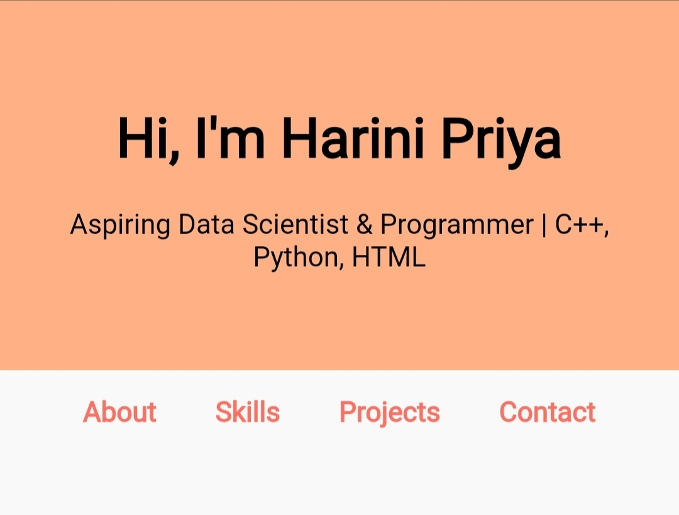
RESULTS AND SCREENSHOTS

Slide 12
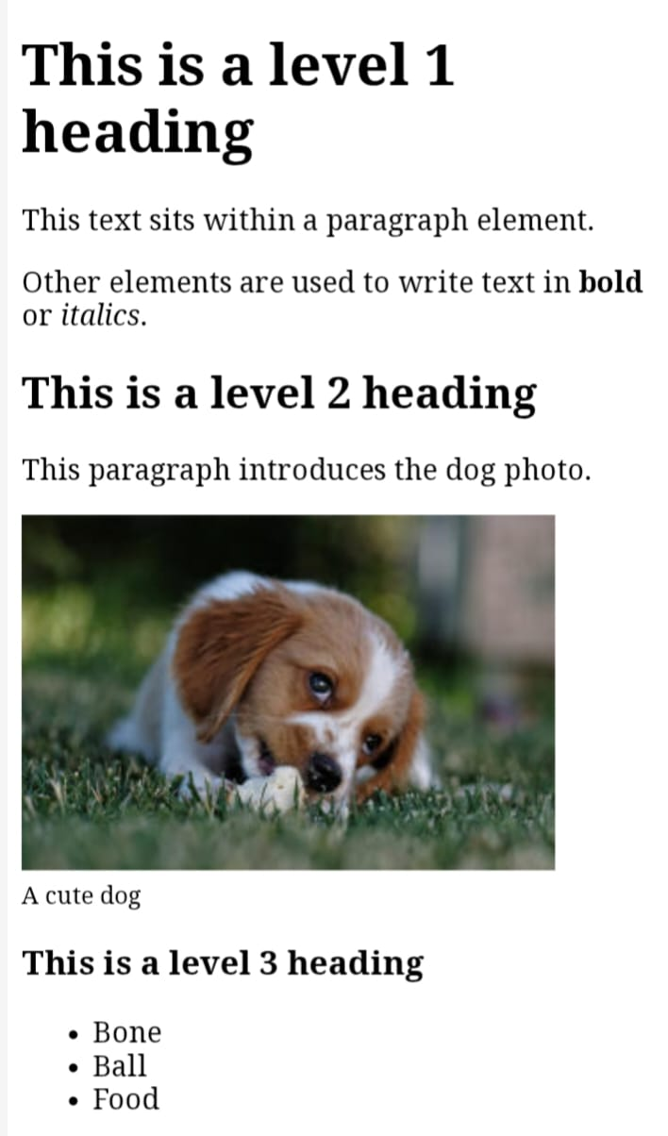
RESULTS AND SCREENSHOTS

Slide 13
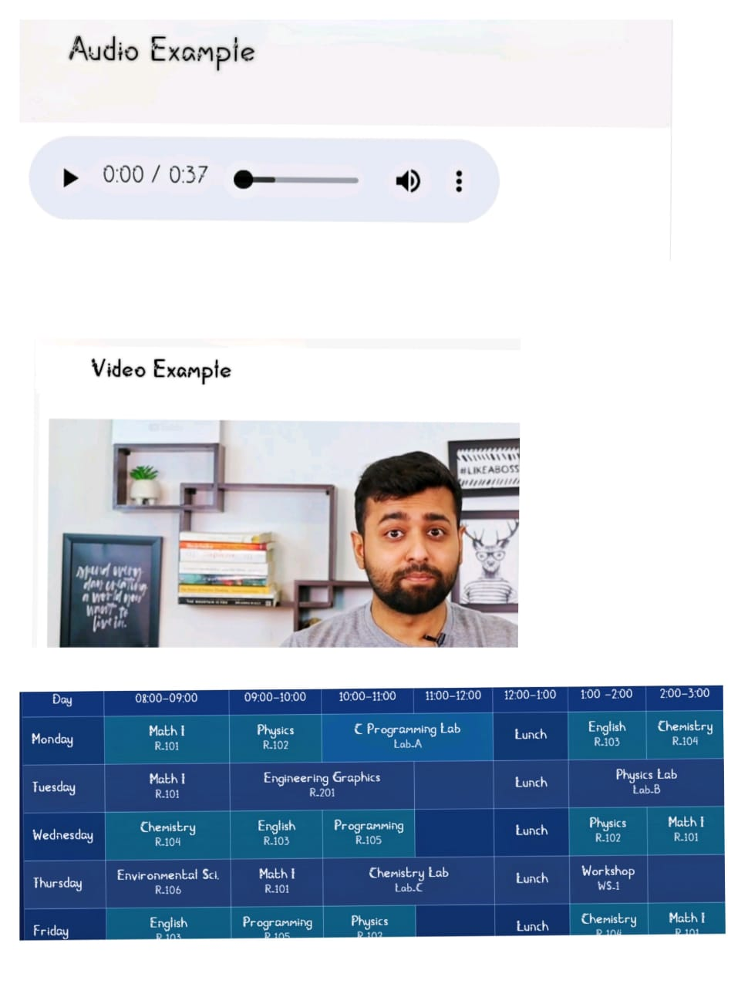
RESULTS AND SCREENSHOTS

Slide 14
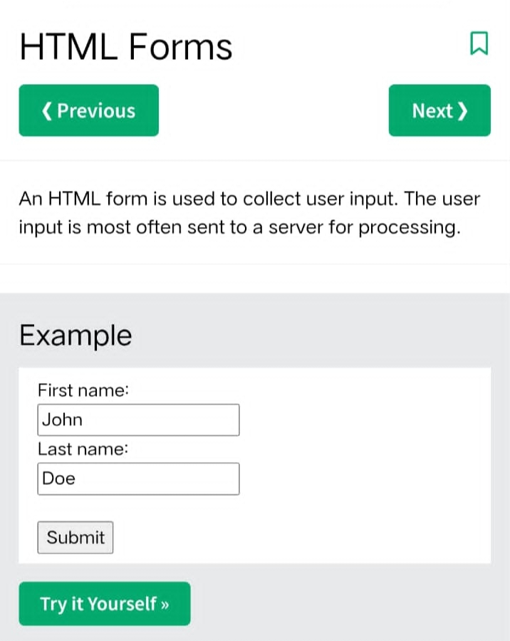
RESULTS AND SCREENSHOTS

Slide 15
CONCLUSION
The digital portfolio showcases key skills in HTML, CSS, and JavaScript through a structured and interactive design. It reflects a practical understanding of web development and personal branding.
15

